Slide 1


Letters and Sounds
Parents information
Junior Learning
Reception

Slide 2




Junior Learning
Letters and Sounds
DfE Validated Phonics programme
Authors
Clare Shivnan - Taylor
Duncan Milne - PHD
Experienced Letters & Sounds Trainer.
Lead teacher for Phonics.
Specialist Leader in Education.
Neuropsychologist.
Expert in field of reading.
International speaker on Phonics.

Slide 3
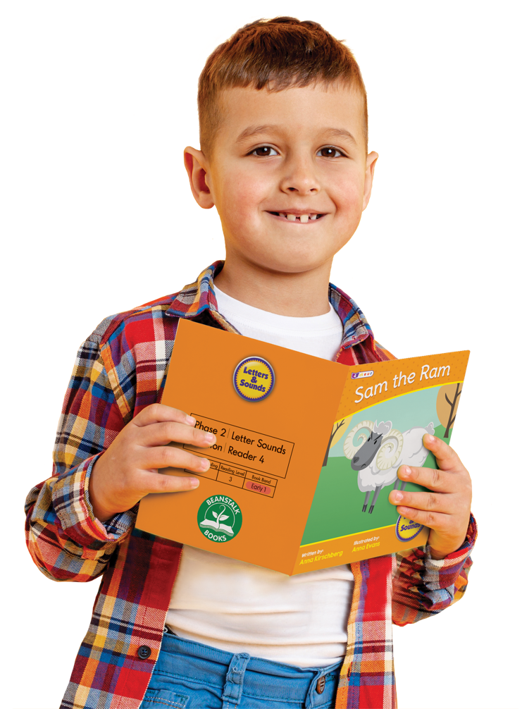
Junior Learning
Letters & Sounds
Systematic progression, where children are introduced to letters in a specific order (s, ɑ, t, p, i, n, m...)
Includes common exception (tricky) words.
6-part Phase Progression (Nursery to Year 2)

Slide 4







Phonics Progression
Reception
Year
Nursery
Reception
Year 1
Year 2
Topic
Phonemic Awareness
Letters Sounds
Phonics
Blends
Vowel
Sounds
Sound
Families
Suffixes
Spelling
Planner
JL700
JL685
JL697
JL699

Slide 5



Phonics Terminology
Question
What is a Phoneme?
- Smallest unit of sound in a word.

Slide 6
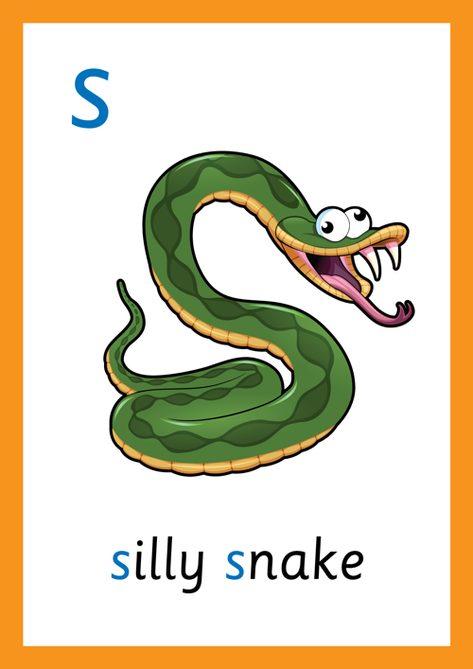


Phonics Terminology
Question
2. What is a Grapheme?
- The letter or symbolic code that shows a sound

Slide 7


Phonics Terminology
Question
3. What is a Diagraph?
- Two letters blended together to make one sound i.e sh

Slide 8


Phonic Terminology
Question
4. What is a Trigraph?
- Three letters blended together to make one sound i.e. igh

Slide 9


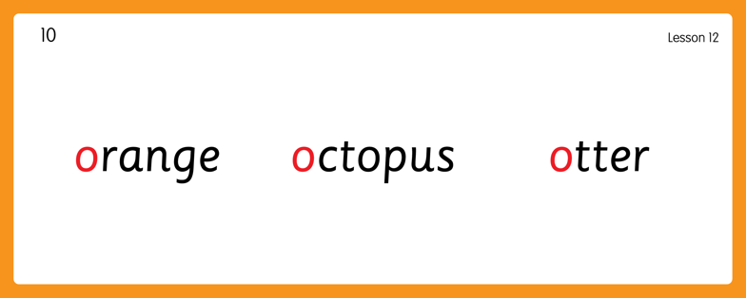
How we teach Phonics
Reception
Hear Phonemes
octopus
otter
orange

Slide 10
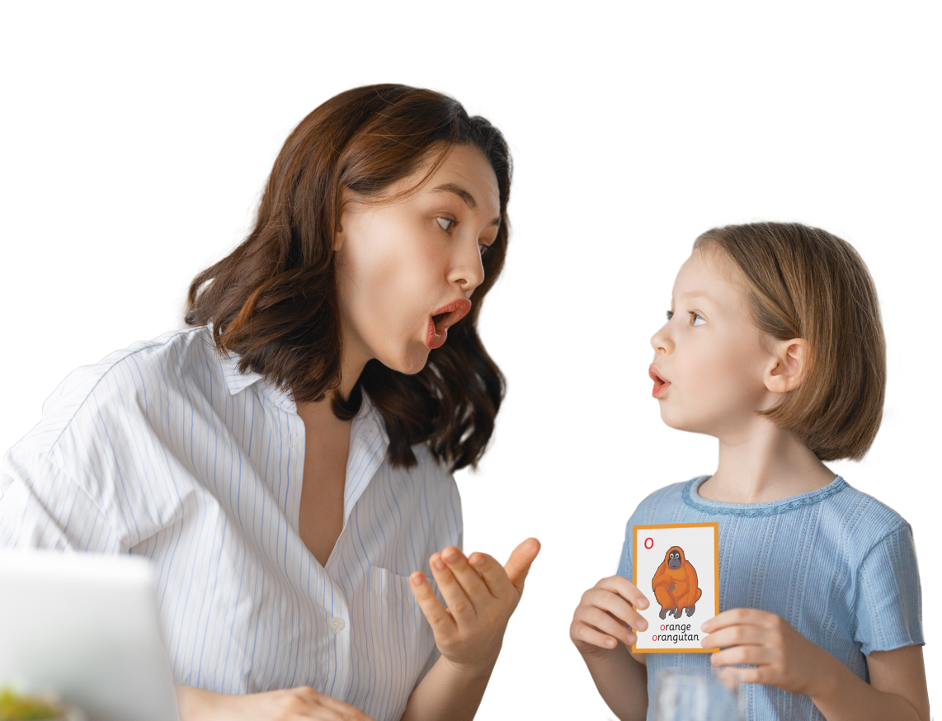

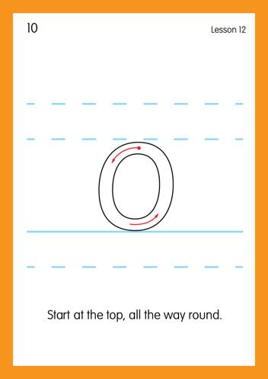
How we teach Phonics
Reception
- Teach Grapheme Caption

Slide 11
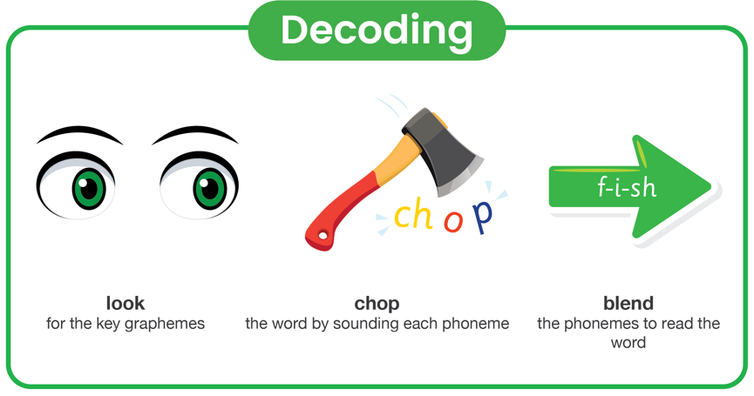
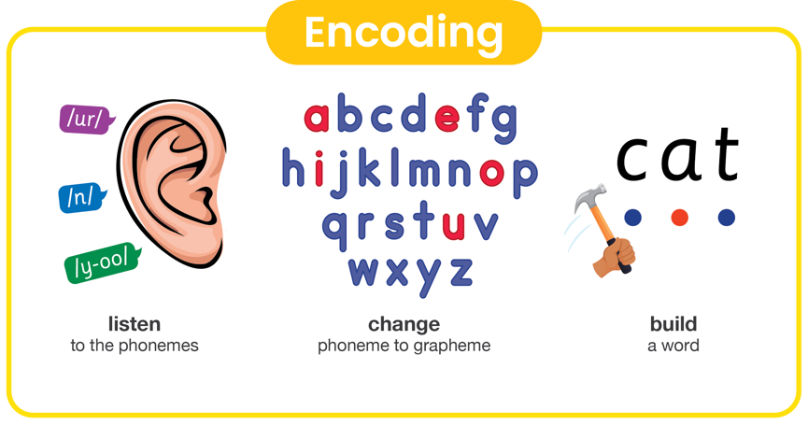
How we teach Phonics
Decoding and Encoding Mnemonic

Slide 12



How we teach Decoding
Reading
Model blending phonemes using sound buttons.
Vowel
Consonant

Slide 13
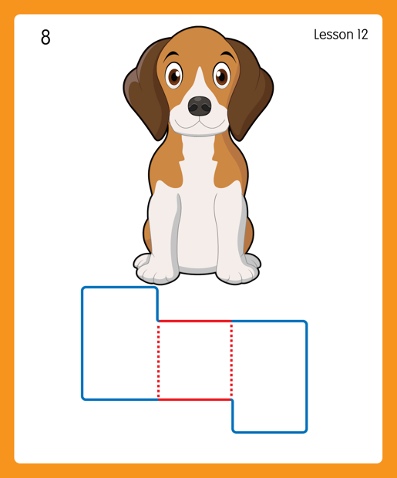


How we teach Encoding
Spelling
Build a word
Vowel
Consonant

Slide 14





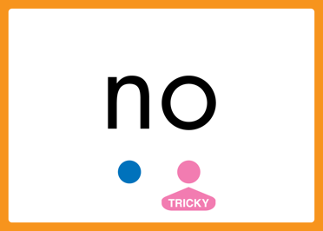
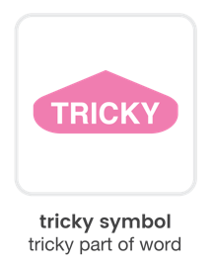
How we teach…
How we teach…
High Frequency words
Tricky words
Vowel
Consonant

Slide 15

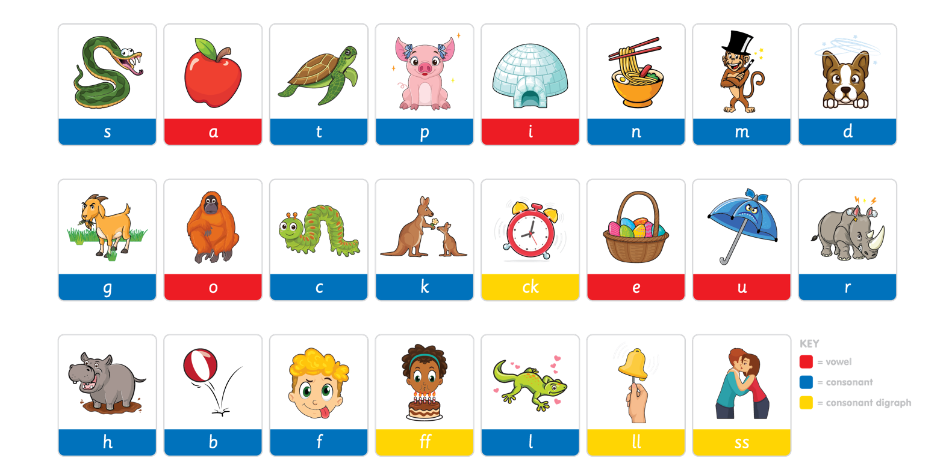
Phoneme Mat
Phase 2 – Letter Sounds
View more resources at www.juniorlearning.co.uk

Slide 16
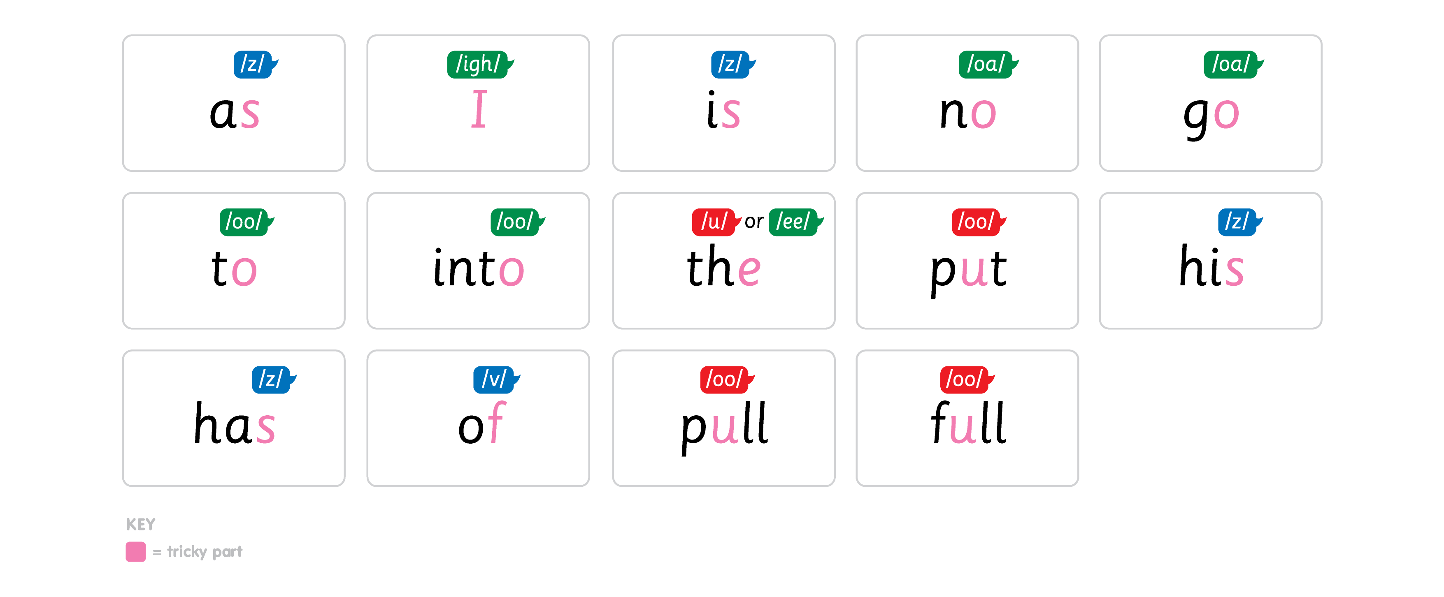
Common Exception Words
Phase 2
View more resources at www.juniorlearning.co.uk

Slide 17
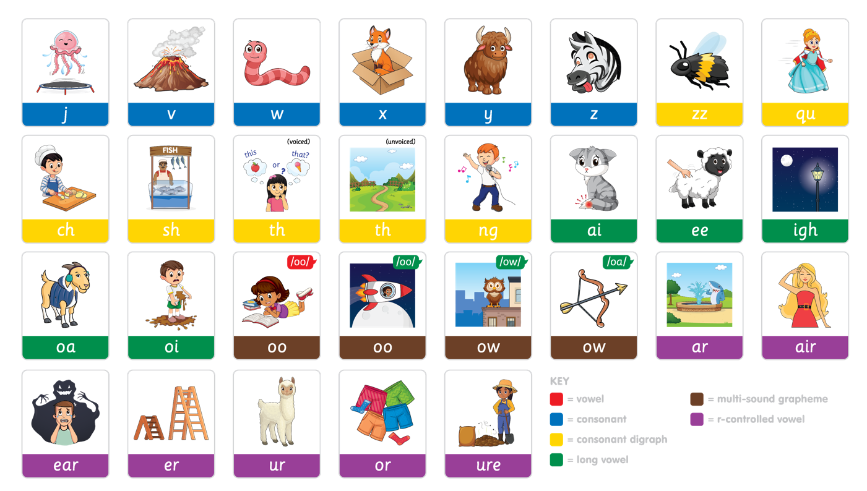
Phoneme Mat
Phase 3 - Phonics
View more resources at www.juniorlearning.co.uk

Slide 18
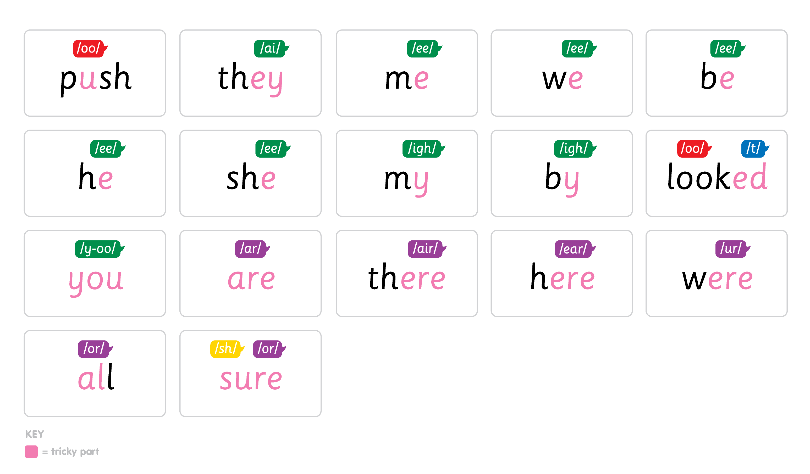
Common Exception Words
Phase 3
View more resources at www.juniorlearning.co.uk

Slide 19
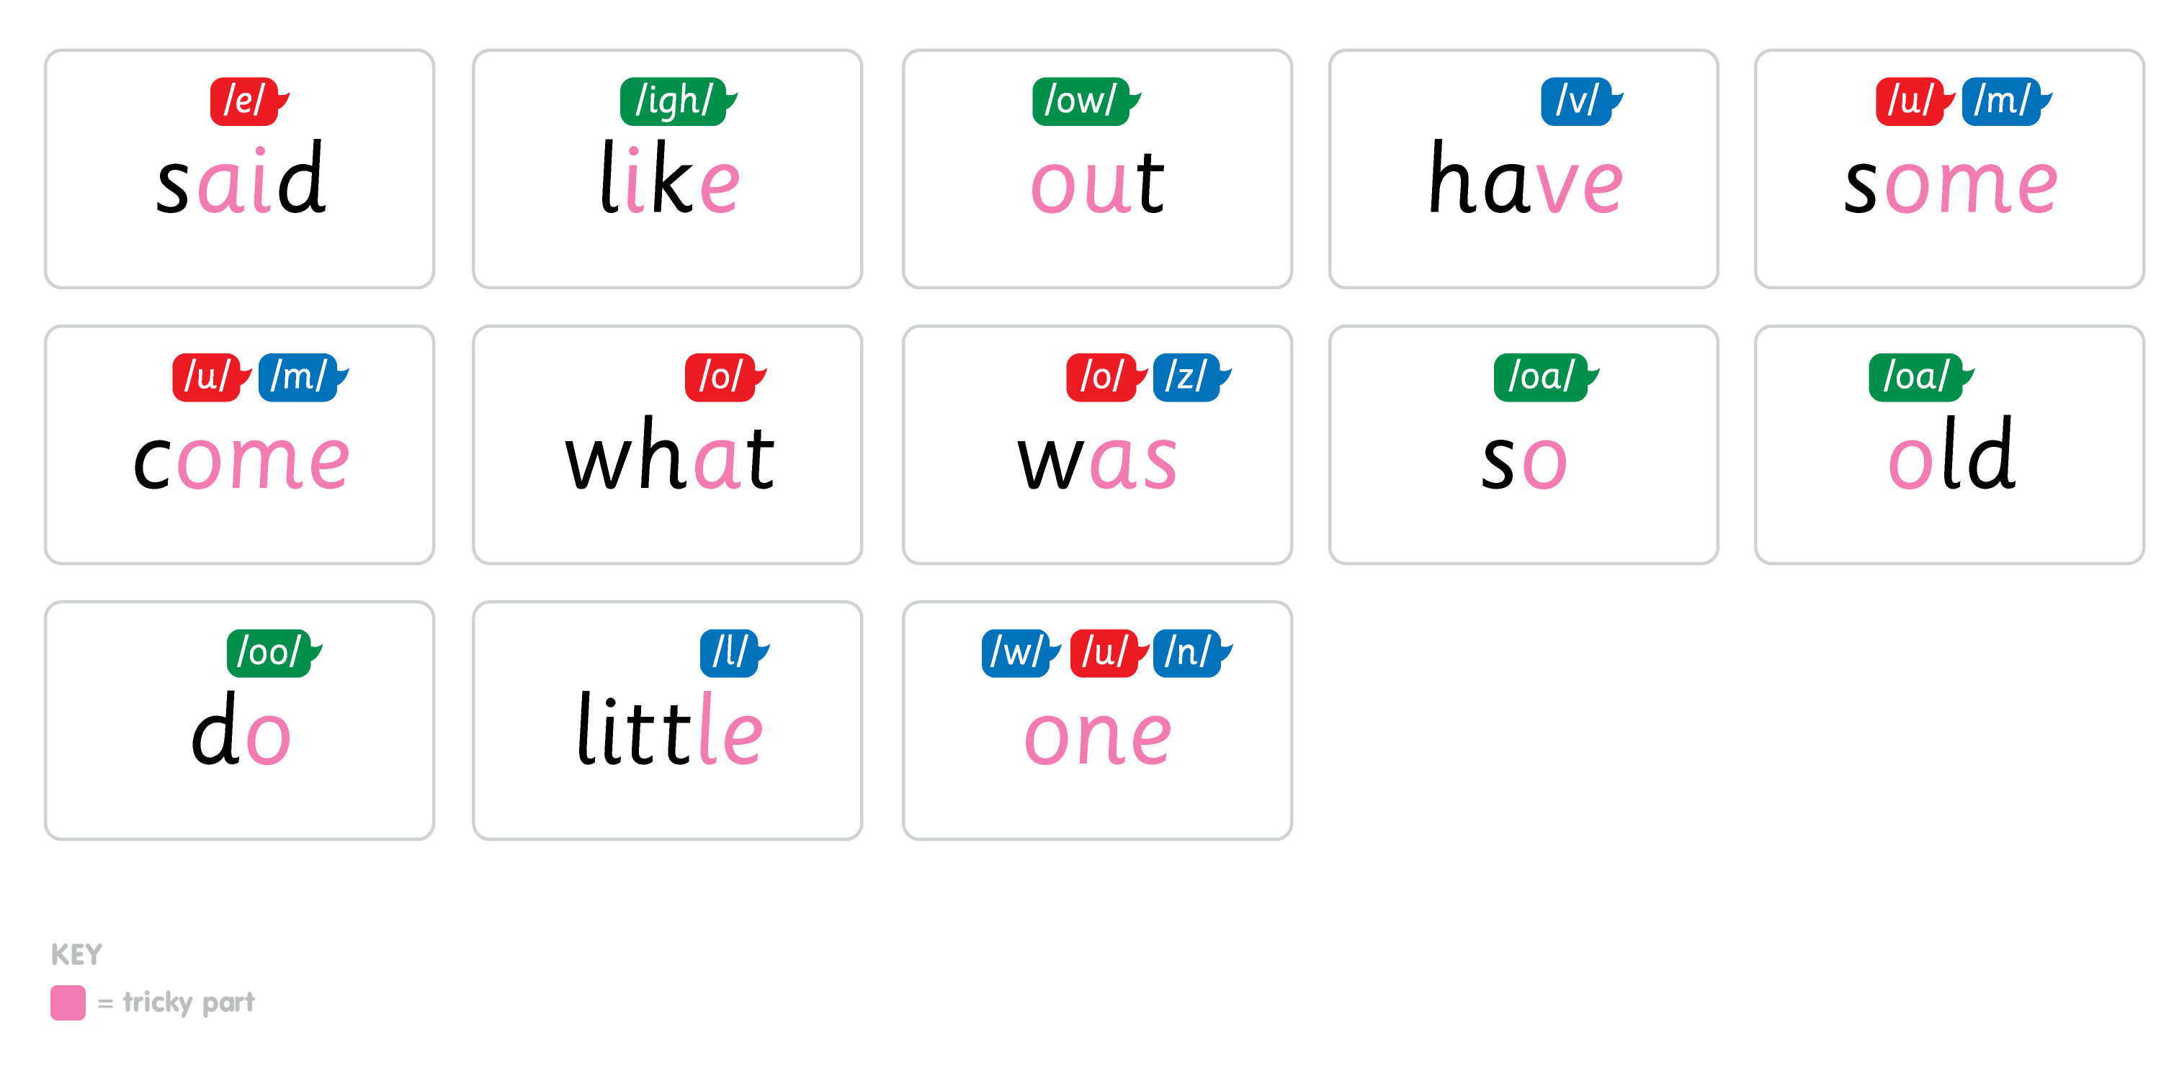
Common Exception Words
Phase 4
View more resources at www.juniorlearning.co.uk

Slide 20
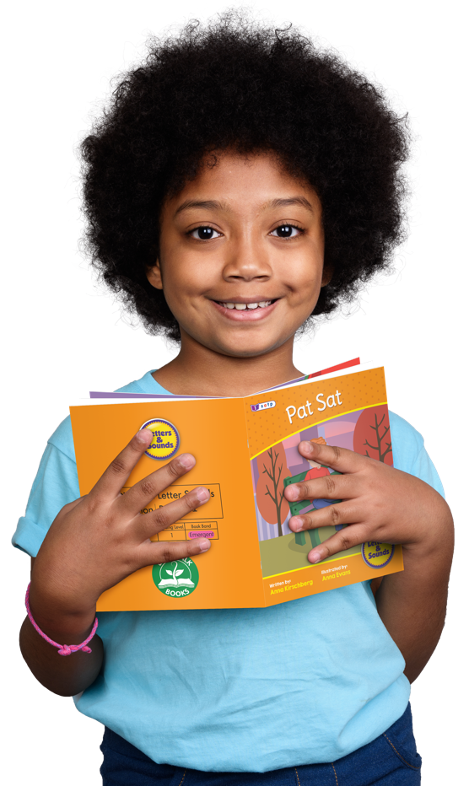
Reading at home
Your child’s home reading book will be matched carefully to the sounds they are secure with in school.
Once your child has decoded (sounded out) an unfamiliar word a number of times they are encouraged to read it automatically without decoding.
Once your child is able to read a number of words automatically we want to encourage fluency, intonation and expression in reading.
The books are a mix of fiction and non-fiction.
Please read to your child as often as possible, children love to listen to stories particularly favourites from home or the library.

Slide 21

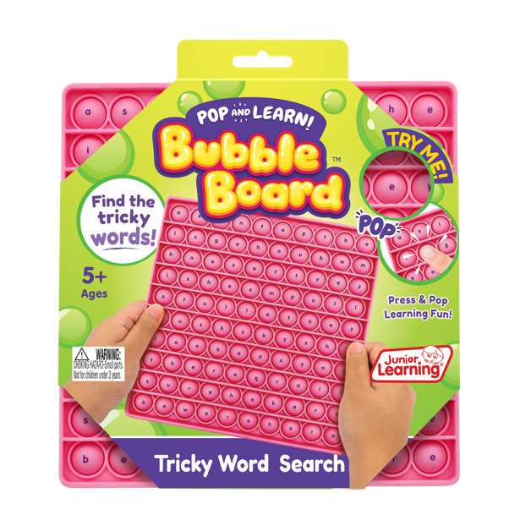
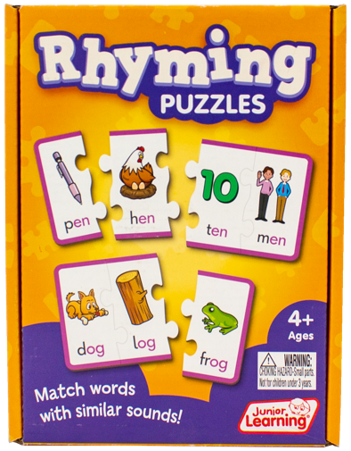
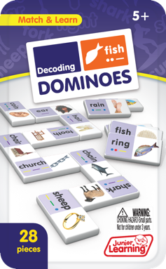
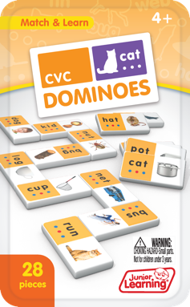
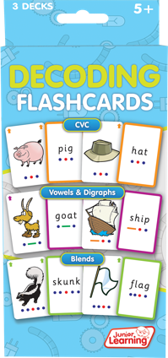
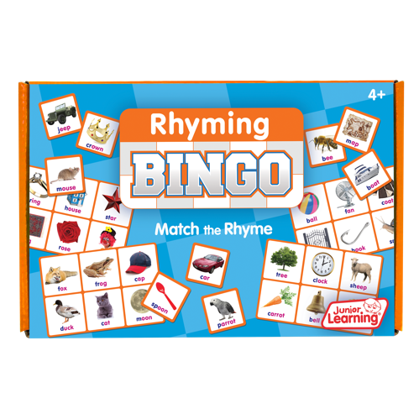
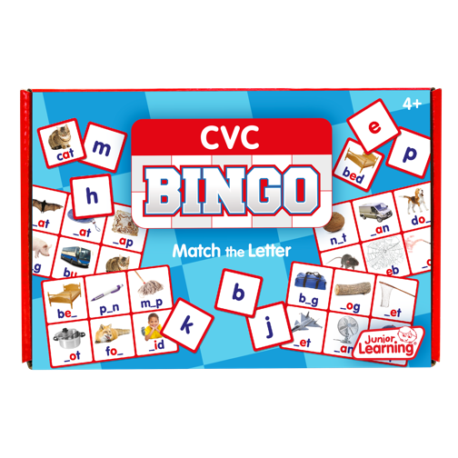

Supporting Reading at Home
View more products at www.juniorlearning.co.uk

